Slide 1
Ignition Hacks
Division Sigma

Slide 2
Agenda
Introduction to Machine Learning
Supervised Learning
Natural Language Processing
Objectives, application, and techniques
Division Sigma Sample Code DEMO
Q & A

Slide 3
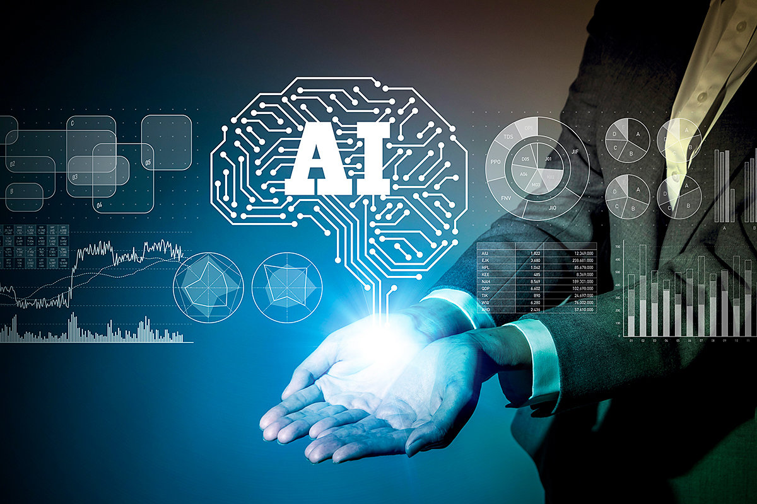
What is AI?
Examples:
Face recognition
Spam detection
Self driving Cars
When a machine or program performs a task that a human would have to apply “intelligence” to do
Computer being intelligent

Slide 4
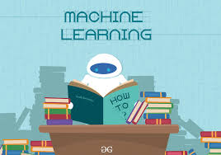
What is Machine
Learning?
A subfield of Artificial Intelligence
Takes data and “learns” from it
Objective: to increase the accuracy of your model

Slide 5
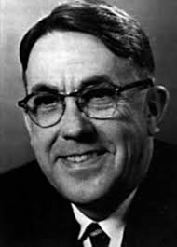
Machine Learning is a field of study that gives computers the ability to learn without being explicitly programmed.
-Arthur Samuel, who popularize the term “Machine Learning” in 1959

Slide 6

Machine Learning
Vs. Traditional
Coding
Traditional
Telling a computer strictly what to do
Ex. Web development, basic spreadsheet creation, etc.
Machine Learning
Teaching a computer how to teach itself
Ex. A virtual assistant learning your voice, etc.

Slide 7
Types of Machine Learning
Supervised, Unsupervised, and Reinforcement Learning

Slide 8
Supervised
Learning
Apply what has been learned in the past to new data
Computer is given an example, and the programmer provide the label to this example.
Similar to a teacher teaching a student

Slide 9
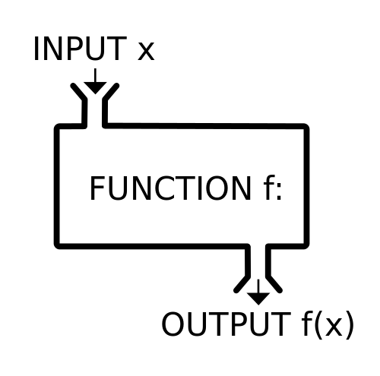
The Function Machine
Both input and output are provided
The machine figures out the function.

Slide 10
Classification vs.
Regression
Problems
Regression
Answer is quantitative
Ex. Determining an range (income)
Classification
Answer is qualitative
Ex. Determining a visual pattern (facial recognition, Image Search)

Slide 11
Natural Language Processing

Slide 12
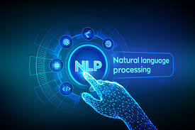
What is NLP?
A branch of AI that deals with the interaction between computers and human using natural language.

Slide 13
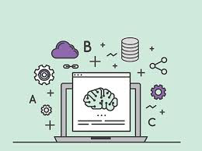
History
The study of NLP generally started in the 1950s.
Up to the 1980s, most NLP systems were based on complex set of hand-written rules.
The introduction of machine learning revolutionized NLP in the late 1980s.
In the 2010s, deep learning (DL) took over due to its ability to achieve many difficult NLP tasks.

Slide 14
Objectives
Read, understand, and make sense of the human language in a manner that is valuable.
Most NLP techniques relies on Machine learning to derive meaning from human languages.

Slide 15
Examples & Applications
General Applications
Language translation
E.g. Google Translate
Word processors
E.g. Grammarly
Interactive Voice Response (IVR)
Personal assistants
E.g. Siri, OK Google
Example of NLP Process
Human talks to machine
Machine captures audio
Audio to text conversion
Processing of text data
Data to audio
Output

Slide 16
How does NLP work?
Uses algorithms to identify and extract the natural language rules so that the unstructured language is converted to a form that the computer can understand.
Sometimes may fail to understand meaning and outputs obscures results due to ambiguity of human language.

Slide 17

NLP Techniques -
Syntax
Syntactic Analysis
Arrangement of words
Alignment between natural language and grammatical rules
Syntactic techniques:
Lemmatization
Morphological Segmentation
Part-of-speech tagging

Slide 18

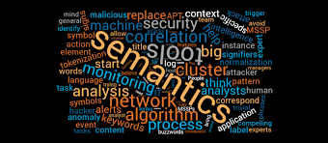
NLP Techniques - Semantics
Semantic Analysis
Meaning conveyed by text
Difficult and not fully resolved
Semantic techniques:
Named entity recognition (NER)
Word sense disambiguation
Natural language generation

Slide 19
Demo Sentiment Analysis
Three important steps to Sentiment Analysis are:
Preprocessing and Vectorization
Model Preparation
Training
Testing the Model

Slide 20

Extra Info
Unsupervised Learning and Reinforcement learning

Slide 21
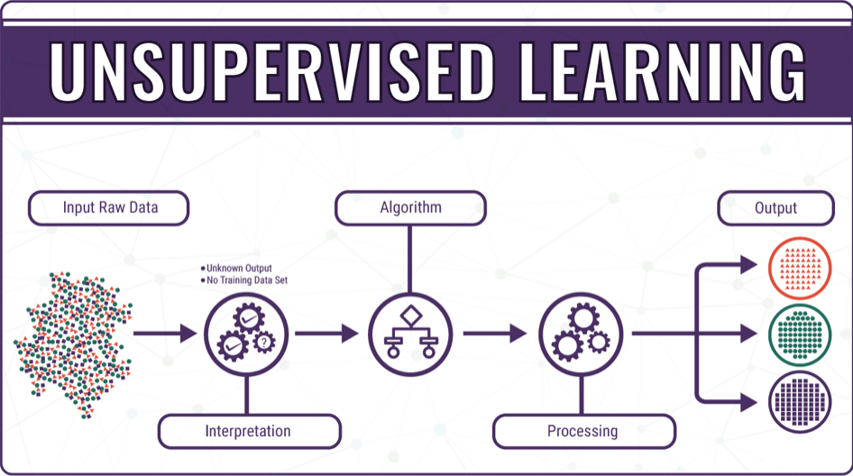
Unsupervised
Learning
Computer learns completely by itself
Takes a series of examples and detects data patterns
Examples:
Marketing automation algorithm

Slide 22
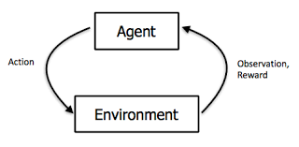
Reinforcement
Learning
Connected to applications
Computer must make decisions, and receives positive or negative feedback in response
Examples:
Google DeepMind
Atari

